Slide 1


Classification
From my measured variables (commonly called features), can I tell which class a sample belongs to?
 | Var 1 | Var 2 | Var 3 | Var 4 | … | … | class
Sample 1 | 12.3 | 53.1 | 2.4 | 5.4 | … | …
Sample 2 | 43.5 | 46.1 | 53.4 | 23.5 | … | …
Sample 3 | 35.6 | 20.5 | 48.4 | 21.6 | … | …
Sample 4 | 44.2 | 24.5 | 1.5 | 28.4 | … | …
Sample 5 | 13.5 | 30.2 | 5.3 | 16.4 | … | …
… | … | … | … | … | … | … | …
healthy
sick

Slide 2
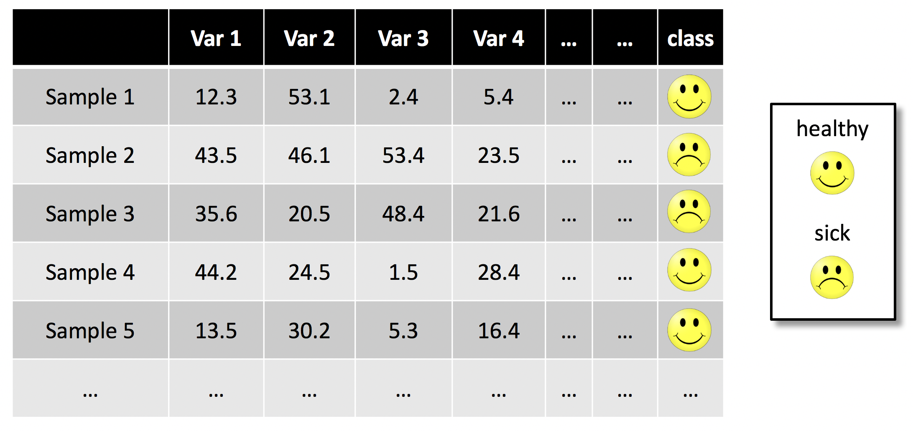
Quiz 1
Which variable(s) classify healthy and sick individuals?
A. Var 1
B. Var 3
C. Var 2 & Var 3
D. Var 1 & Var 4

Slide 3
Quiz 1
Answer: Var 3 separates healthy from sick (in the part of the data that we see)
 | Var 1 | Var 2 | Var 3 | Var 4 | … | … | class
Sample 1 | 12.3 | 53.1 | 2.4 | 5.4 | … | …
Sample 2 | 43.5 | 46.1 | 53.4 | 23.5 | … | …
Sample 3 | 35.6 | 20.5 | 48.4 | 21.6 | … | …
Sample 4 | 44.2 | 24.5 | 1.5 | 28.4 | … | …
Sample 5 | 13.5 | 30.2 | 5.3 | 16.4 | … | …
… | … | … | … | … | … | … | …
healthy
sick

Slide 4
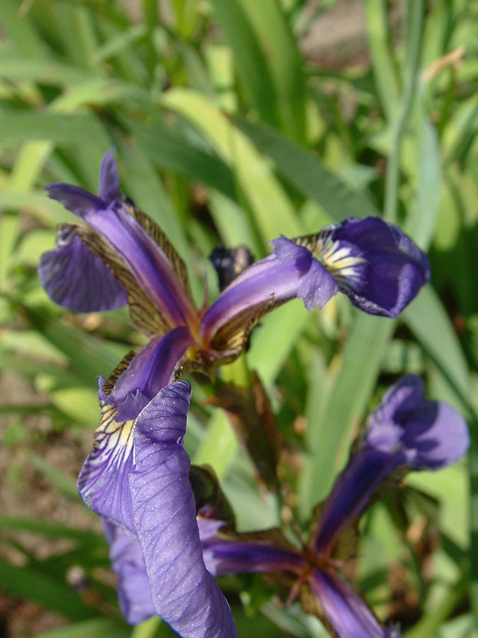
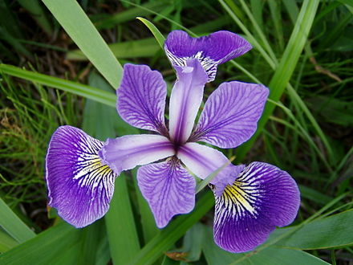
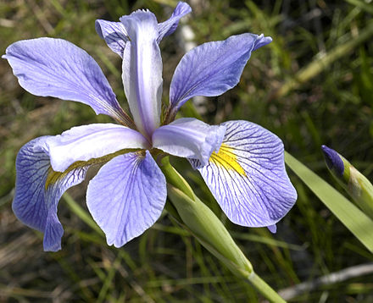
Examples of classification
Healthy vs. sick
Image processing (is there a car in the photo?)
Credit card fraud detection (are transactions “appropriate”?)
Iris species
https://www.r-bloggers.com/machine-learning-for-identification-of-cars/
Setosa
Versicolor
Virginica
https://commons.wikimedia.org/w/index.php?curid=170298

Slide 5
Some other classifiers

Slide 6
K-nearest neighbors classifier
Assign the most common class among the k-nearest training observations.
”nearest” in the sense of distance (e.g. Euclidean) in the feature space
feature 2
?
?
Example:
3-nearest neighbors
feature 1

Slide 7
K-nearest neighbors classifier
Assign the most common class among the k-nearest training observations.
”nearest” in the sense of distance (e.g. Euclidean) in the feature space
feature 2
Example:
3-nearest neighbors
feature 1

Slide 8
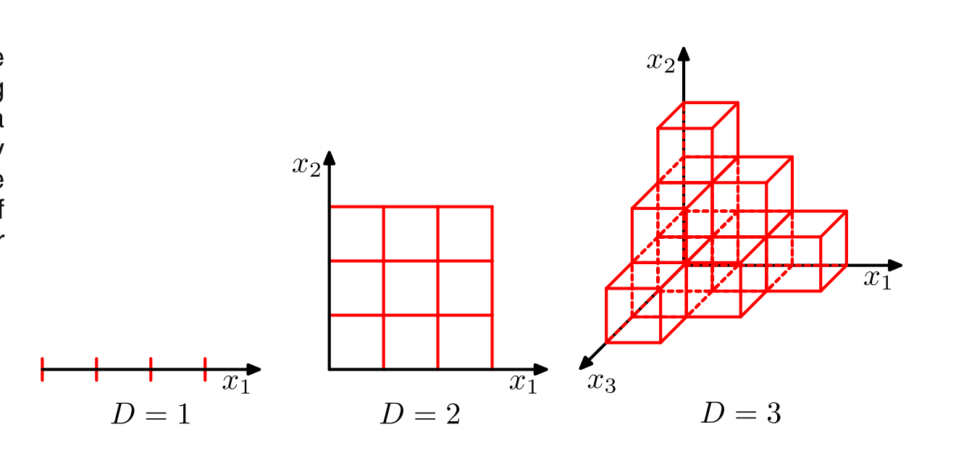
K-nearest neighbors classifier fails in high dimensions
Curse of dimensionality: The volume of the space grows exponentially with the number of features.
Too little data to estimate densities in a non-parametric fashion as with k-NN.
We need more modeling assumptions, to ”extract the features”.
Pattern Recognition and Machine Learning, C. Bishop

Slide 9
Neural networks
Logistic regression:
Logistic regression is one simple form of neural network
Deep neural networks model more complex functions by composing successions of linear transformations and non-linear activation functions
Notes:
$$c(\mu) = \begin{cases} 1 & \mu\geq 0.5 \\ 0 & \mu < 0.5 \end{cases} $$

Slide 10
Support vector machines
Vladimir Vapnik: Modeling the probability of a class, as in logistic regression, is a too difficult problem. Often, we only care about discriminating. We need a different loss function
Find a hyperplane (p-1 dimensional space) which
Separates the two classes
Maximizes the margin (distance to closest data points)
https://en.wikipedia.org/wiki/Support_vector_machine

Slide 11
Support vector machines: non-linear extensions
Soft margins (for imperfect separation)
Tradeoff between margin size and “slack” variables
(which allow for misclassified points)
https://emilea-stat.stochastik.rwth-aachen.de/cgi- bin/WebObjects/EMILeAstat.woa/wa/module?module= 384C2AD2-4504-714A-C17D-90C3A4EFEB82
Kernel machines (for non-linear classification)
Non-linear transformation does not need
to be performed explicitely (➔ “Kernel trick”)
https://en.wikipedia.org/wiki/Support_vector_machine

Slide 12
Decision trees
decision tree for classification
very intuitive and interpretable
quantitative values require discretization (e.g ”BMI>=30”)
decision tree algorithms are usually information-theory based (e.g. Gini coefficient)

Slide 13
Random forests
One instance of “Ensemble learning”, a strategy that is robust to overfitting and allows fitting very flexible functions.
Forest: The output is a majority vote of many decision trees.
Random: Each tree is fitted on a random sampling of the data, with random subset of the features.

Slide 14
Classifiers - overview
K-nearest neighbors: only in very low dimensions. Almost never used in practice
Logistic regression: interpretable -> often used in practice. Non-linearities are not learnt. They must be engineered in the features “by hand”. The number of dimensions must be lower than the number of data points.
SVM, Random forests and Neural networks are the most widely used for complex, “black box” models. Most popular nowadays are deep neural networks for images and sequences (natural language processing, bioinformatics). Random forests are also popular in more general settings.

Slide 15
Assessing classifiers

Slide 16
Confusion matrix
classifiers claims sample is positive (e.g. sick), and it’s correct
classifiers claims sample is negative, but it’s actually positive
predicted class
positive
negative
TP | FN
FP | TN
positive
type II error
true class
negative
classifiers claims sample is positive, but it’s actually negative
classifiers claims sample is negative, and it’s correct
type I error
➔ A classifier should maximize true positives (TP) and true negatives (TN), and minimize false negatives (FN) and false positives (FP)

Slide 17
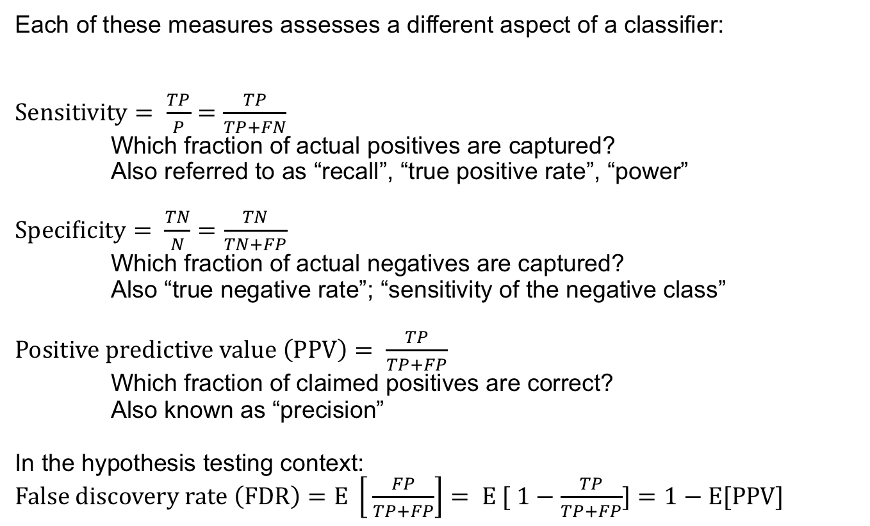
Quality measures (selection)
Each of these measures assesses a different aspect of a classifier:
$Sensitivity= \frac{TP}{P}=\frac{TP}{TP+FN}$ Which fraction of actual positives are captured?
Also referred to as “recall”, “true positive rate”, “power”
$Specificity= \frac{TN}{N}=\frac{TN}{TN+FP}$ Which fraction of actual negatives are captured? Also “true negative rate”; “sensitivity of the negative class”
$Positive predictive value \left(PPV\right)= \frac{TP}{TP+FP}$ Which fraction of claimed positives are correct? Also known as “precision”
In the hypothesis testing context:
$False discovery rate \left(FDR\right)=E \left[ \frac{FP}{TP+FP}\right]= E [ 1−\frac{TP}{TP+FP}]=1−E[PPV]$

Slide 18
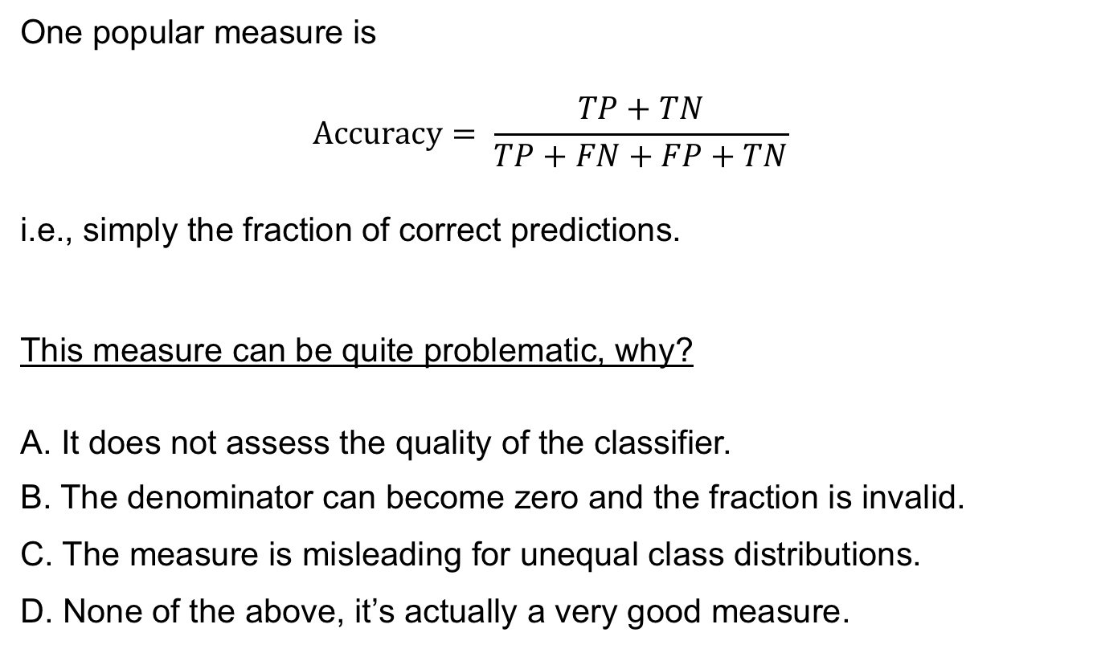
Quiz
One popular measure is
$$Accuracy= \frac{TP+TN}{TP+FN+FP+TN}$$
i.e., simply the fraction of correct predictions.
This measure can be quite problematic, why?
A. It does not assess the quality of the classifier.
B. The denominator can become zero and the fraction is invalid.
C. The measure is misleading for unequal class distributions.
D. None of the above, it’s actually a very good measure.

Slide 19
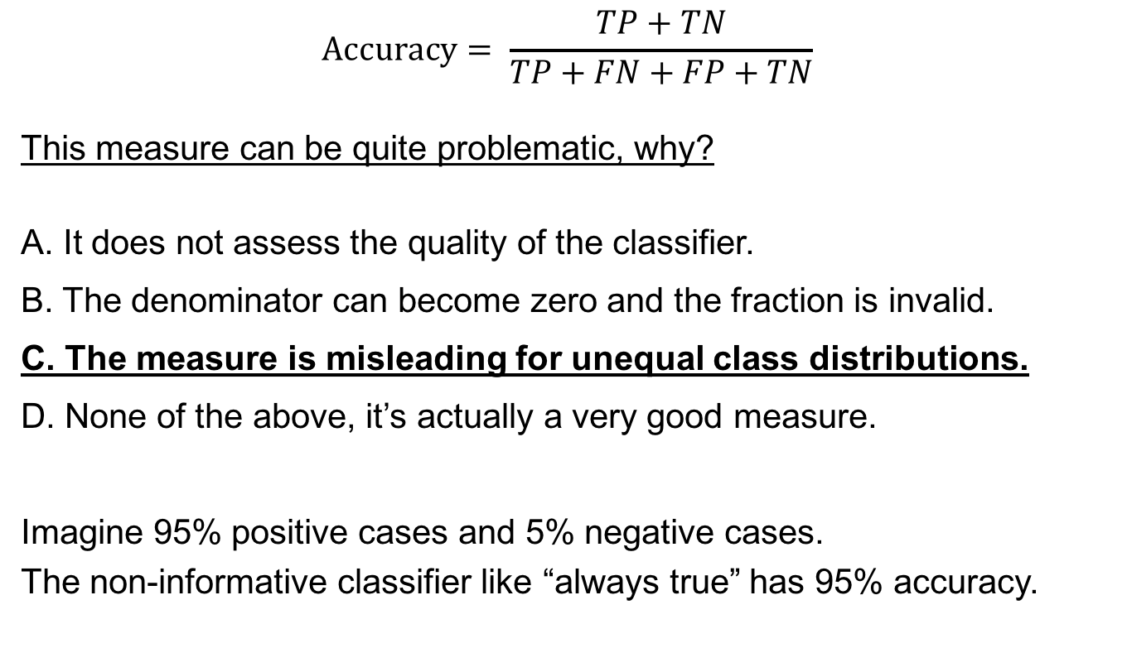
Quiz
$$Accuracy= \frac{TP+TN}{TP+FN+FP+TN}$$
This measure can be quite problematic, why?
A. It does not assess the quality of the classifier.
B. The denominator can become zero and the fraction is invalid.
C. The measure is misleading for unequal class distributions.
D. None of the above, it’s actually a very good measure.
Imagine 95% positive cases and 5% negative cases. The non-informative classifier like “always true” has 95% accuracy.

Slide 20
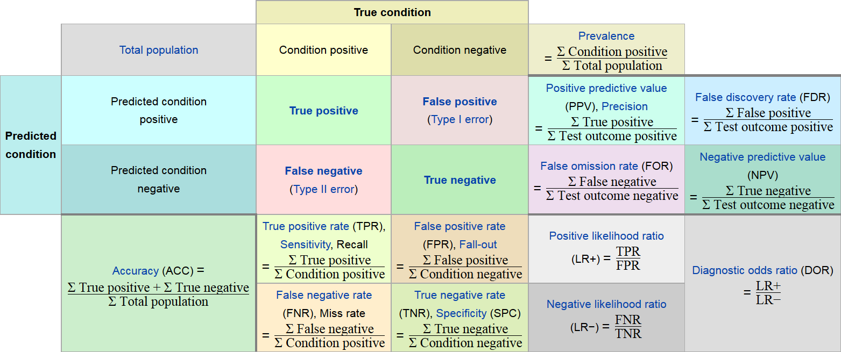
Comprehensive overview on Wikipedia
https://en.wikipedia.org/wiki/Sensitivity_and_specificity

Slide 21
Choosing a classification cutoff
Many classification methods to not directly assign a class, but rather output a “score”
For example, recall the linear predictor from generalized linear models:
We have to set a cutoff above which we call a “positive”.
For logistic regression, this cutoff is often at 0, but could be somewhere else.

Slide 22
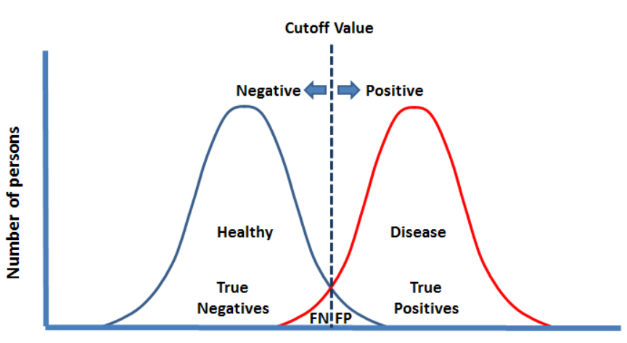
The choice of the cutoff influences the performance metrics
Which cutoff to choose?
score
http://www.drcoplan.com/dsm5-the-case-for-double-standards

Slide 23
The choice of the cutoff influences the performance metrics
Which cutoff to choose?
score
http://www.drcoplan.com/dsm5-the-case-for-double-standards

Slide 24
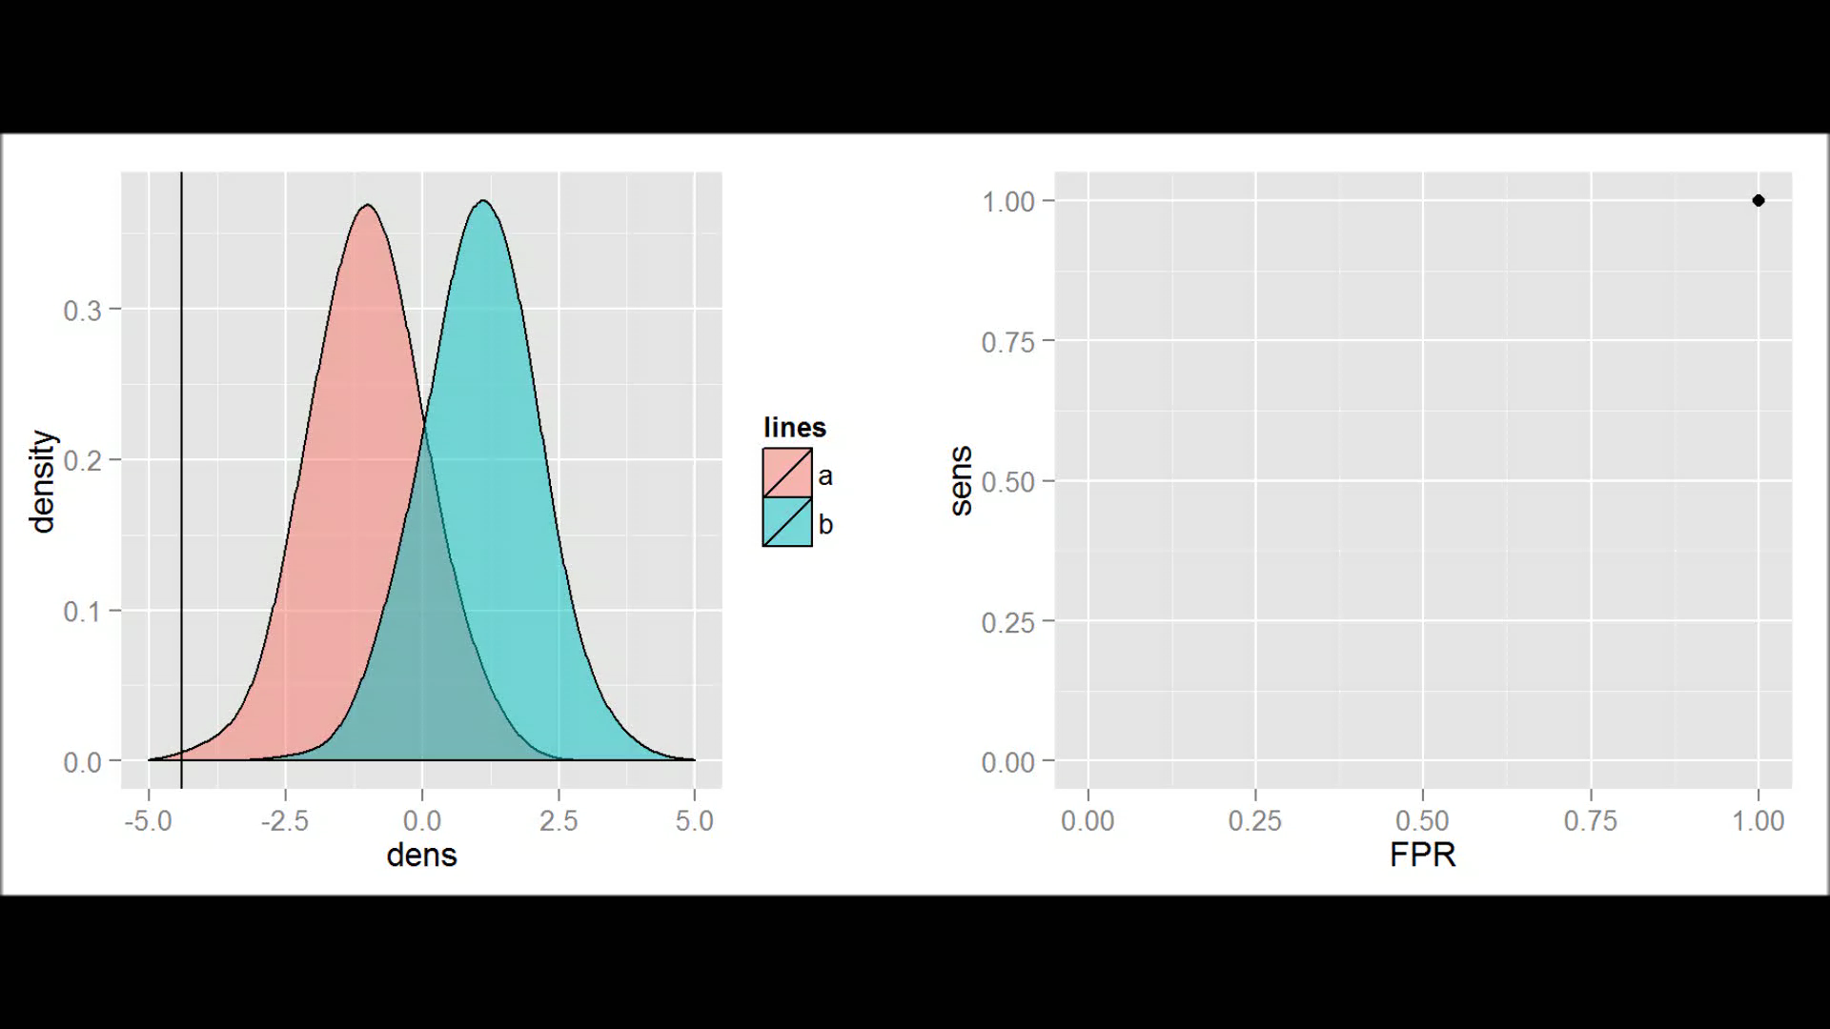
Receiver operating characteristics (ROC) curves
1000 in positive class (blue), 1000 in negative class (red)
The x-axis on left panel is the score.
FPR = false positive rate =
1 - specificity
Area under the curve (AUC) = 0.926

Slide 25
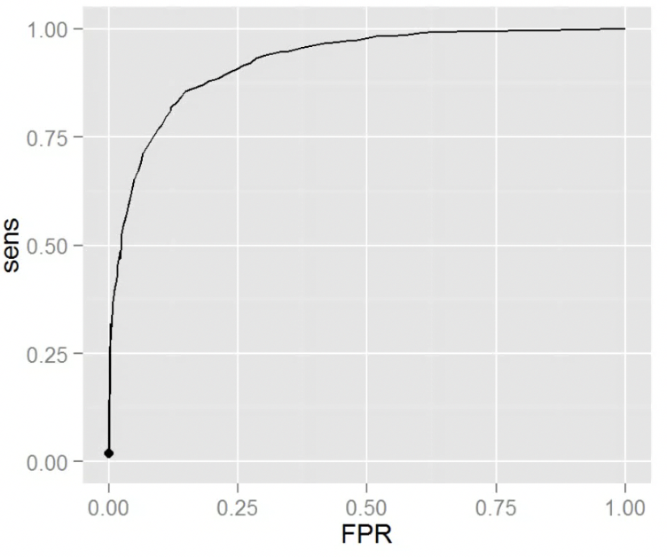
Quiz
What is the optimal trade-off between sensitivity and FPR in a ROC curve?
At 0.5 sensitivity
At 0.5 FPR
At the closest point to the upper left
It depends on the question
C
B
A

Slide 26
Quiz
What is the optimal trade-off between sensitivity and FPR in a ROC curve?
At 0.5 sensitivity
At 0.5 FPR
At the closest point to the upper left
It depends on the question
There is no standard solution. Some problems might need very high sensitivity (e.g. diagnosing cancer) whereas others might need high specificity (e.g. credit card fraud dectection).

Slide 27


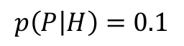
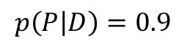
How good is enough for clinical practice?
D = diseased
H = healthy
P = test is positive (claims subject is sick)
$$p\left(P | D\right)=0.9$$
90% sensitivity = true positive rate
$$p\left(P | H\right)=0.1$$
10% false positive rate = 90% specificity
positive predictive value (PPV) = 33.3%

Slide 28
The problem: class imbalance
Learning the predictor with balanced classes
(e.g.: case / control study)
PPV = 90%
Real population
Imbalanced classes (eg. due to low disease prevalence)
PPV = 33.3%

Slide 29
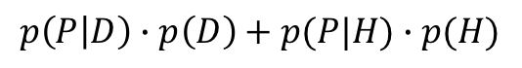
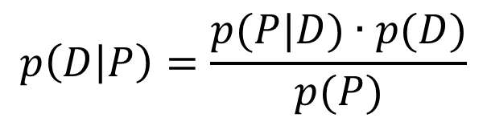
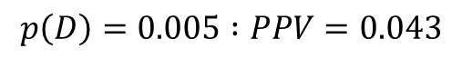
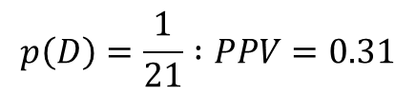
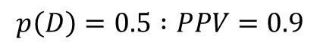
Another way to calculate this: Bayes’ theorem
D = diseased
H = healthy
P = test is positive (claims subject is diseased)
sensitivity = 0.9
prevalence of the disease
$$p\left(D\right)=0.5 :PPV=0.9$$
$$p\left(D | P\right)=\frac{p(P|D)∙p(D)}{p(P)}$$
$$p\left(D\right)=\frac{1}{21} :PPV=0.31$$
$$p\left(D\right)=0.005 :PPV=0.043$$
PPV
fraction of positive tests
$$p\left(P | D\right)∙p\left(D\right)+p(P|H)∙p(H)$$

Slide 30



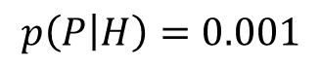
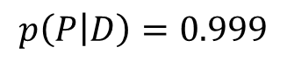
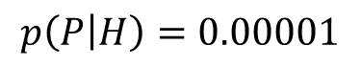
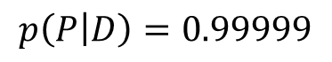
Possible solutions to the problem
$$p\left(P | D\right)=0.999$$
$$p\left(P | D\right)=0.99999$$
better tests
2) second line of screening
$$p\left(P | H\right)=0.001$$
$$p\left(P | H\right)=0.00001$$
subject to a better / more expensive test,
or to non-invasive interventions

Slide 31
Training classifiers robustly

Slide 32
Complex models can overfit
Models can have hyperparameters that control their complexity, e.g. the degree of a polynomial, the depth of a decision tree, the number of layers of a deep neural network.
More complex models are more flexible but can overfit data.
https://en.wikipedia.org/wiki/Overfitting
The blue curve fits the data points too well.
Most probably, extraplotation outside this range only works with the linear fit.

Slide 33
Performance should be evaluated on held-out data (test set)
A test dataset is not used during model fitting (held-out data)
training
set
Test set
fit
model
apply
features
class
model quality
(sens., spec., ROC AUC ...)
If the model learned a pattern that does not generalize,
the quality on the test set will be low

Slide 34
Performance on test assess error in generalization and show optimal model complexity
underfitting
optimal
overfitting
Learning ”by heart” indicates a model with too high complexity
http://learning.cis.upenn.edu/cis520_fall2009/index.php?n=Lectures.Overfitting

Slide 35
Cross-validation
Goal: Identify optimal model complexity without peeking into the held-out test dataset.
Cross-validation does so by mimicking test set evaluations using training data only.

Slide 36
Cross-validation
Example: 3-fold cross-validation
fit
model
Training
apply
Validation
features
class

Slide 37
Cross-validation
Example: 3-fold cross-validation
Training
fit
apply
model
Validation
fit
Training
features
class

Slide 38
Cross-validation
Example: 3-fold cross-validation
apply
Validation
fit
model
Training
features
class

Slide 39
Cross-validation
When doing k-fold cross-validation, we get k results. Quality measures need to be aggregated (e.g. averaged) over the k folds.
Cross-validation is used to select the best model

Slide 40
Cross-validation pitfalls
Issue:
Assumption: the training samples and the test samples are independently and identically distributed.
Non identical distribution:
Training set = red apples and green pears
Test set contains green apples
Training set = observational data
Test set = perturbation data
…
Non-independent distribution…

Slide 41
Cross-validation: when i.i.d. assumption is not met
Assume the data come in clusters you are not aware of
e.g: repeated measures, people from same families,
homologous genes etc.
A simulated dataset of repeated measures. The between replicate simulated trend is y=x

Slide 42
Cross-validation: when i.i.d. assumption is not met
Performing cross-validation at the level of individual data points will favor models that learns the clusters

Slide 43
Cross-validation: when i.i.d. assumption is not met
One need to perform cross-validation at the cluster level to learn the trend across clusters.
This is difficult without application knowledge. Visualization techniques can help.

Slide 44
To remember
Classification
Logistic regression: model and interpretation
Principle of k-nn, SVM, neural network and random forest
Confusion matrix and related metrics
ROC curve
Prevalence
Cross-validation

Slide 45
References
Many slides on logistic regression have been made by modifying materials from the book "Introduction to Data Science - Data Analysis and Prediction Algorithms with R" by Rafael A. Irizarry.
https://rafalab.github.io/dsbook/index.html
ROC Graphs: Notes and Practical Considerations for Data Mining Researchers, T. Fawcett
http://www.hpl.hp.com/techreports/2003/HPL-2003-4.pdf
Elements of statistical learning, T. Hastie et al.
Pattern Recognition and Machine Learning, C. Bishop.

